Slide 1
NYPD Shooting Incident Data: Review and Data Analysis
JF Schultz
DTSA 5031
Oct 29, 2020
Notes:
Thank you
DATA PROJECT – SHOOTING INCIDENTS IN NEW YORK CITY
WHAT LEARNED –→ REDUCING SHOOTINGS IN FUTURE

Slide 2
NYPD Shooting Incident Data: Review and Data Analysis
This video presentation
and
the accompanying R code
are available at
https://github.com/miniwheat/DTSA-5301

Slide 3
Introduction
OBJECTIVE: Import, tidy, and analyze NYPD Shooting Incident Data
Review Data
Question of Interest
Visual Analysis
Modeling and Statistical Analysis
Discussion
Notes:
STARTED – SIMPLE OBJECTIVE: DATA SET - REVIEW – FORUMULATE
HOW DATA REVIEWED / CLEAED
QUESTION: VARIATION IN NUMBER SHOOTING BY BOROUGH
VISUAL ANALYSIS → MODELING AND STATISTICAL ANALYSIS TO CONFIRM

Slide 4
The Data
Public Repository
NYPD Data
2006 - 2021
13 variables
25.6 K Records
https://data.cityofnewyork.us/Public-Safety/NYPD-Shooting-Incident-Data-Historic-/833y-fsy8
Notes:
- FROM PUBLIC REPOSITORY – AVAILABLE TO ALL
- COMPILED BY NYPD – FROM REPORTED INCIDENTS - EXTRACTED QUARTERLY, REVIWEED BY OFFICE OF MANAGEMENT ANALYSIS AND PLANNING
- 15 YEAR PERIOD 2006 – 2021
- VARIABLES: DATE/TIME, LOCAITON / BOROUGH / PRECINCT / GEOSPATIAL DATA; SUSPECT / VICTIM DEMOGRAPHIC/RACIAL DATA
- INCIDENT = RECORD - OVER 25K FOR REVIEW

Slide 5
Data Prep
Review dataset
Unwanted variables
Variable classes
Bad values
Missing values
Notes:
- REVIEW: WHAT VARIABLES, HOW CODED (class, type), ANOMALIES (coding, bad values)
- REMOVING UNWANTED VARIABLE
- RECODING: VARIABLE CLASSES (factor / date) – EASIER TO HANDLE IN R
- IDENTIFY BAD VALUES (bad age values) - don’t foul analysis
- UNIFORM CODING MISSING VALUES
- EXPLORATORY DATA ANALYSIS

Slide 6
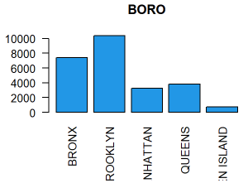
Exploratory Data Analysis
Notes:
EXPLORATORY DATA ANALYSIS → QUESTION OF INTEREST
VARIATION BETWEEN DIFFERENT BUROUGHS
NORMALIZED DATA – CENSUS BEAREAU DATA FOR POPULATION TO NORMALIZE TO PER CAPITA RATES
BRONX / BROOKLYN

Slide 7
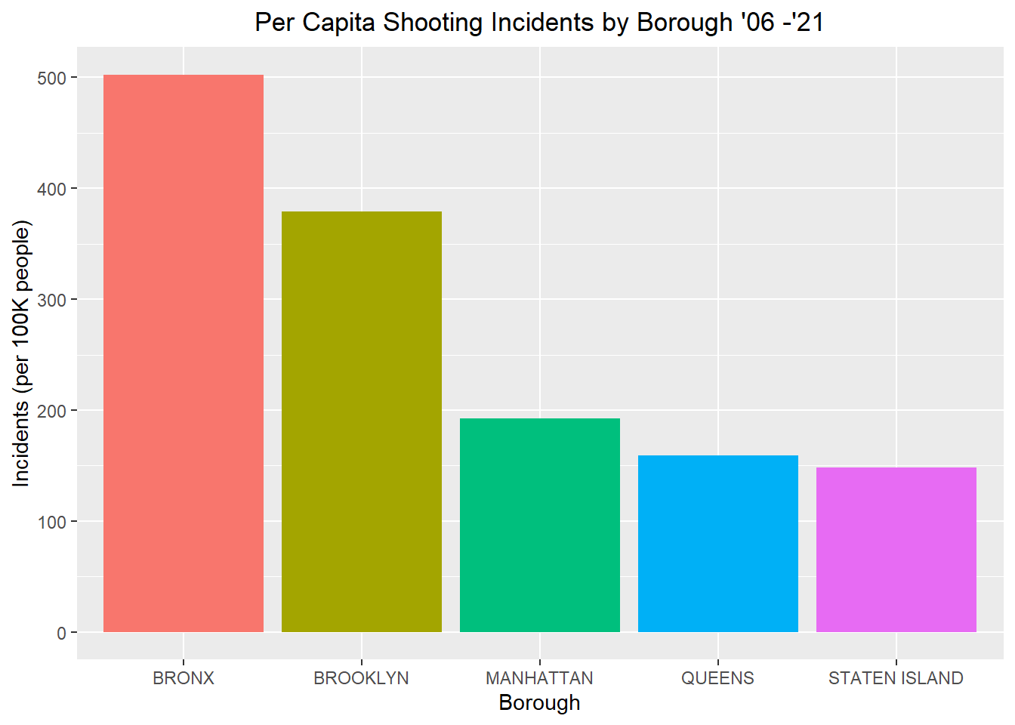
Analysis by Borough
Notes:
PER CAPITA - BRONX / BROOKLYN STILL MOST

Slide 8
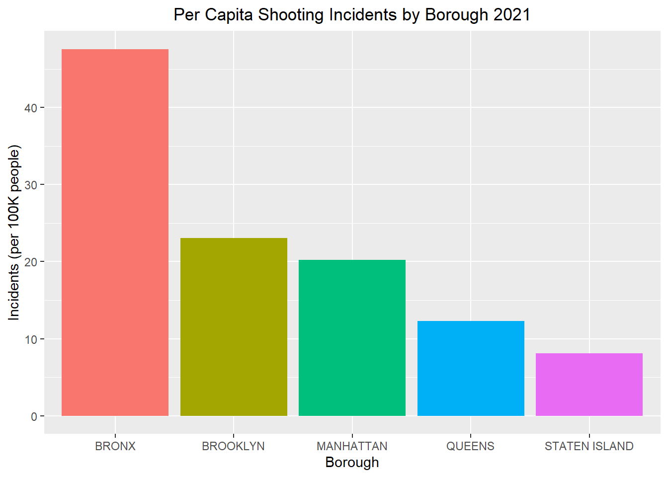
Analysis by Borough
Notes:
2021 – NOT SUCH A MARKED DIFFERENCE BRONX / BROOKLYN
? CHANGE ? DIFFERENCE ? CAUSE

Slide 9
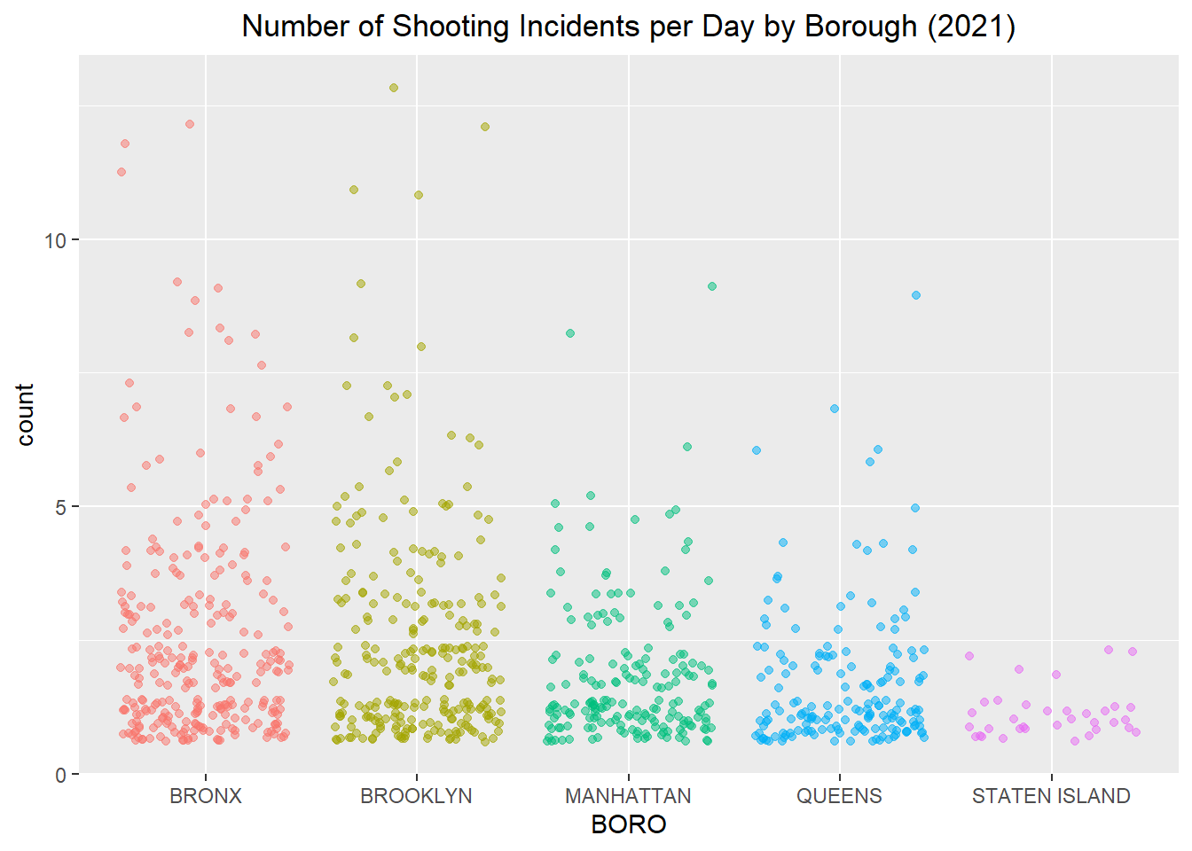
Analysis by Borough
Notes:
DAY BY DAY VISUALIZATION – APPRECIATION FOR VARIATION
OVERALL NUMBERS
VARIATION WITHIN A PARTICULAR BOROUGH
DIFFICULT TO INTERPRET MEANS

Slide 10
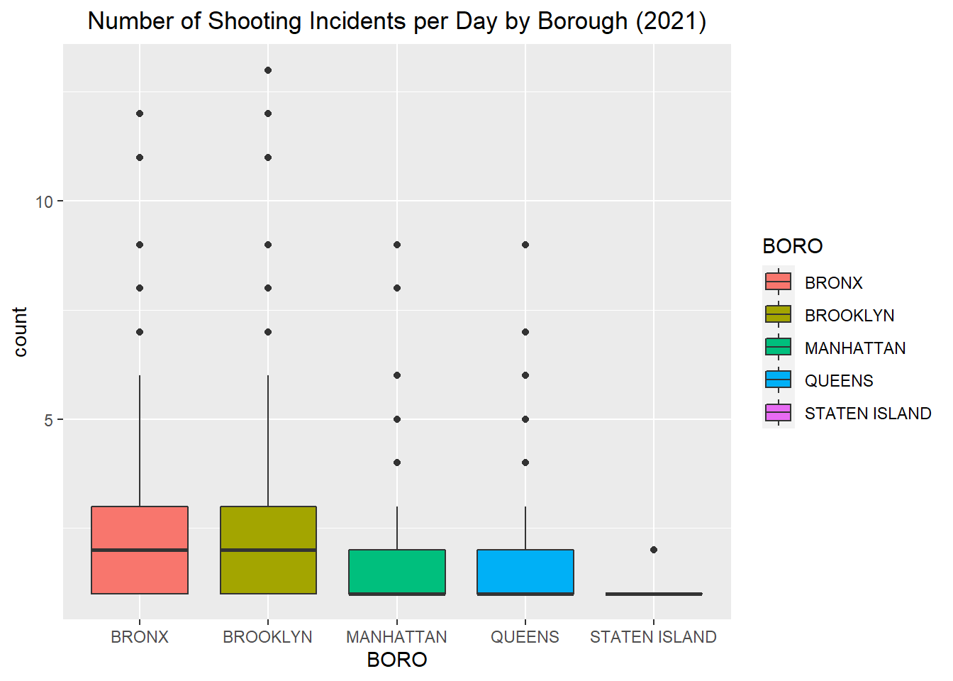
Analysis by Borough
Notes:
BOXPLOT – EASIER TO SEE MEANS (HEAVY BLACK LINE IN MIDDLE OF BOX)
SUGGESTS BRONX / BROOKLYN DIFFERENT – MHTN/QUEENS DIFFERENT - STATEN ISLAND DIFFERENT
APPARENT → TEST WITH MODELING AND STATISTICAL ANALYSIS

Slide 11
Modeling and Statistical Analysis
Generalized Linear Model
Poisson Response
Dependent: Borough
Valid Model
Differences exist
Notes:
IN ORDER TO TEST DIFFERENCES
GLM CONSTRUCTIED – COUNT INC/DAY AS POISSON RESPONSE – ON BOROOUGH AS INDEPENDENT VARIABLE
TESTING OF MODEL ON RESIDUAL DEVIANCE AND d.f USING CHI SQUARED TEST – MODEL VALID (# SHOOTINGS / DAY RELATED TO BOROUGH)
ANOVA TESTING CONFIRMS – DIFFERENCE EXITS
FURTHER TESTING DETERMINE WHAT DIFFERENCE – ESTIMATED MARGINAL MEANS PACKAGE with BONFERRONI CORRECTION

Slide 12
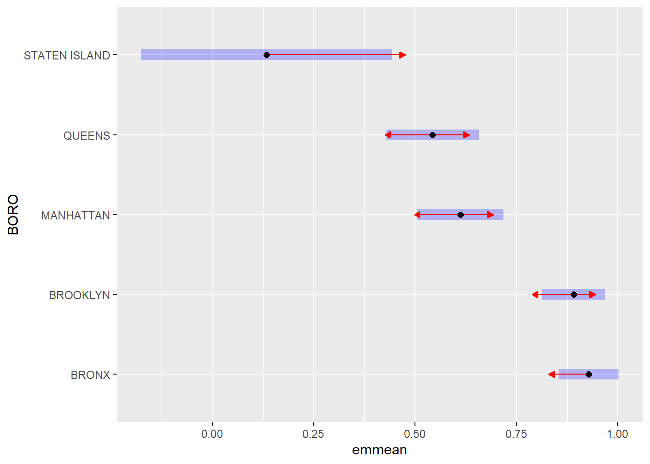
Modeling and Statistical Analysis
BRONX 0.92849
BROOKLYN - 0.03801
MANHATTAN - 0.31651
QUEENS - 0.38563
STN ISLAND - 0.79496
Notes:
EMMEANS PACKAGE – NICE VISUALIZATION OF DIFFERENCE BETWEEN MEANS OF GROUPS
MEANS AND CONFIDENCE INTERVALS – OVERLAP OR NOT ?
MODEL PREDICTION? PARAMETER ESTIMATES FROM GLM FOR EACH BOROUGH
MOVING FORWARD

Slide 13
Discussion
Data Collection
Under reporting
Inherent bias
Interpretation
Recommendations
https://github.com/miniwheat/DTSA-5301
https://data.cityofnewyork.us/Public-Safety/NYPD-Shooting-Incident-Data-Historic-/833y-fsy8
Notes:
MOVING FORWARD – CHANGES TO REDUCE # SHOOTINGS
POTENTIAL ISSUES w DATA COLLECTION
ACTUAL != REPORTED – MAY BE ISSUES W UNDER-REPORTING
(NO INJURY, POLICE AVAILABILITY / RECEPTABILITY / RESPONSE, FEAR OF RECRIMINATION, COMMUNITY BELIEFS / PERCEPTIONS)
POSS INHERENT BIAS IN DATA COLLECTION – eg RACIAL DATA MAY SUGGEST PRE-CONCEIVED NOTION
CAUTION W INTERPRETATION – RESULTS ARE VIEWED IN PERSONAL CONTEXT (MAYOR, POLICE CHIEF, RESIDENT, TOURIST, SOCIAL WORKER, PASTOR, CRIMINAL)
RECOMMENDATIONS
- DISPARITY EXISTS – SOCIAL / POLITICAL SIGNIFICANCE
DISCIPLINED APPROACH – HELP UNDERSTAND UNDERLYING CAUSES
FURTHER ANALYSIS AND MORE INFORMATION

